Slide 1


Bug-bytes
Housing Sale
Price Prediction
Prepared By: Puja Karmakar - 20194981
Weaam Ajoor - 20196537
Vanshika Sharma - 20161218

Slide 2
Table of contents
01
Different Models
02
Our Approach
03
Outcomes
04
Q & A Session

Slide 3

Problem
Predicting the sale price of a house based on its features.
Addressing Non-linearity, Outliners, Data and Model evaluation and analysis.

Slide 4
Different Models
01

Slide 5
S.no | Method Name | Private score
1 | XGBoost Regression | 0.14672
2 | Random Forest Regression | 0.17646
3 | Gradient Boosting | 0.20
4 | Neural Networks | 0.24278
5 | Decision Tree | 0.25
6 | LGBM Regression | 0.30
7 | SVM | 0.53

Slide 6
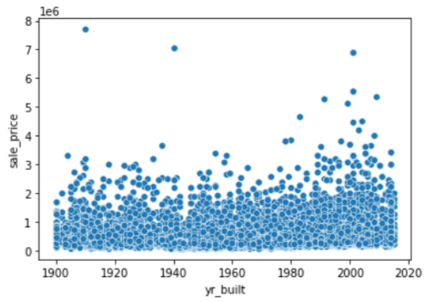
Abnormalities on Dataset
Properties with 0 Bedrooms and
0 Bathrooms we dropped them.
Properties with 33 Bedrooms in a column extreme outliner.
Min yr_built - 1900 and Max yr_built - 2015 tried tacklings by creating a column age.

Slide 7
Our Approach
02

Slide 8
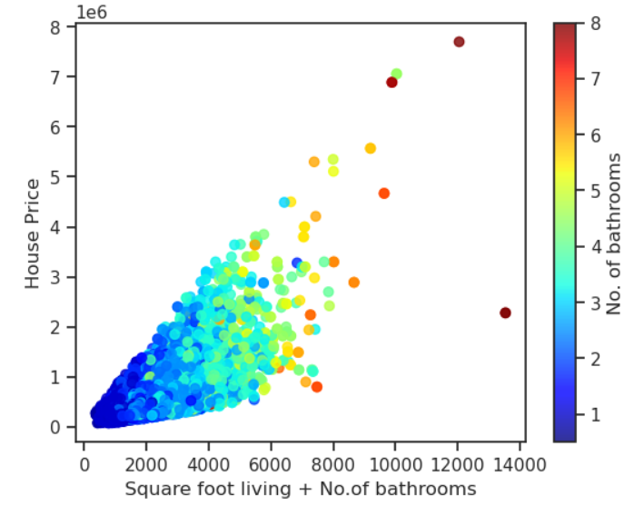
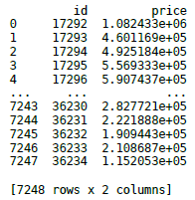
XGBoost Regressor
Custom tree building algorithm
Ensemble learning method
In build cross validation capability
Parallelized tree building
Results of regression problems are continuous values
Metrics - RSME and MSE
metersq_living and bathroom has the highest relation with house price

Slide 9
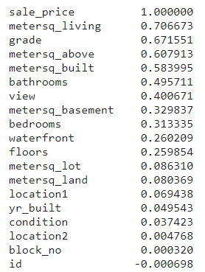
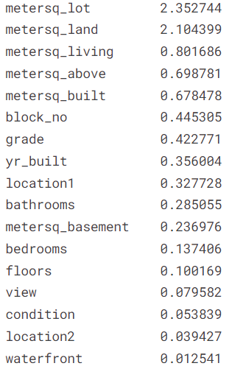
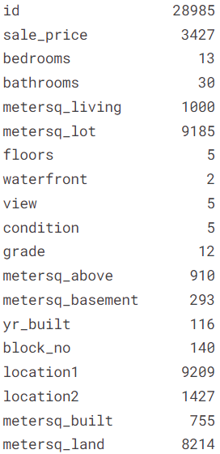
Housing Dataset Features
Correlation with sale_price
Unique numbers in Housing dataset
MI Score

Slide 10
You may wonder, why these parameters .. ?
colsample_bytree
Controls the fraction of columns to be randomly sampled during each tree construction. It can help to reduce overfitting.
learning_rate
Controls the step size at each iteration. A lower learning rate can lead to more accurate models, but requires more iterations.
max_depth
Controls the maximum depth of the individual trees in the ensemble. Setting the value too high can lead to overfitting.
n_estimators
Controls the number of trees in the ensemble.
verbosity
Controls the amount of information printed during the training process. This parameter does not have a direct effect on accuracy, but useful for understanding the model's behavior.
Notes:
colsample_bytree: This parameter controls the fraction of columns to be randomly sampled during each tree construction. It can help to reduce overfitting by introducing more randomness into the model. Increasing the value of colsample_bytree can lead to better accuracy on the test data, up to a certain point. However, setting the value too high can lead to underfitting.
learning_rate: This parameter controls the step size at each iteration while moving toward a minimum of the loss function. A lower learning rate can lead to more accurate models, but requires more iterations. Conversely, a higher learning rate can lead to faster convergence, but may cause the model to overshoot the optimal solution and result in lower accuracy.
max_depth: This parameter controls the maximum depth of the individual trees in the ensemble. Increasing the value of max_depth can lead to a more complex model, which may fit the training data better. However, setting the value too high can lead to overfitting, which can reduce accuracy on the test data.
n_estimators: This parameter controls the number of trees in the ensemble. Increasing the value of n_estimators can lead to better accuracy, up to a certain point. However, setting the value too high can lead to overfitting.
verbosity: This parameter controls the amount of information printed during the training process. Setting the verbosity to 0 means that no information is printed, while setting it to a higher value can provide more detailed information about the training process. This parameter does not have a direct effect on accuracy, but can be useful for debugging and understanding the model's behavior.

Slide 11
Outcomes
03

Slide 12
What we learnt ..?
01
02
Effect of Hyperparameters
Preprocess
Datasets
03
04
05
Feature Dropping Effect and Grid Search
Data Visualisation
Techniques
Evaluating Models

Slide 13
Q & A Session
04

Slide 14

Thank you!

